Slide 1
Quicksort

Slide 2
Performance
Worst-case execution time – Θ(n²).
Average-case execution time – Θ(n lg n).
  How do the above compare with the complexities of other sorting algorithms?
Empirical and analytical studies show that quicksort can be expected to be twice as fast as its competitors.

Slide 3
Design
Follows the divide-and-conquer paradigm.
Divide: Partition (separate) the array A[p..r] into two (possibly empty) subarrays A[p..q–1] and A[q+1..r].
  Each element in A[p..q–1] ≤ A[q].
  A[q] ≤ each element in A[q+1..r].
  Index q is computed as part of the partitioning procedure.
Conquer: Sort the two subarrays by recursive calls to quicksort.
Combine: The subarrays are sorted in place – no work is needed to combine them.
How do the divide and combine steps of quicksort compare with those of merge sort?

Slide 4
Pseudocode
Quicksort(A, p, r)
if p < r then
q := Partition(A, p, r);
Quicksort(A, p, q – 1);
Quicksort(A, q + 1, r)
fi
Partition(A, p, r)
x, i := A[r], p – 1;
for j := p to r – 1 do
if A[j] ≤ x then
i := i + 1;
A[i] ↔ A[j]
fi
od;
A[i + 1] ↔ A[r];
return i + 1
A[p..r]
5
A[p..q – 1]
A[q+1..r]
Partition
5
≤ 5
≥ 5

Slide 5
Example
p r
initially: 2 5 8 3 9 4 1 7 10 6 note: pivot (x) = 6
i j
next iteration: 2 5 8 3 9 4 1 7 10 6
i j
next iteration: 2 5 8 3 9 4 1 7 10 6
i j
next iteration: 2 5 8 3 9 4 1 7 10 6
i j
next iteration: 2 5 3 8 9 4 1 7 10 6
i j
Partition(A, p, r)
x, i := A[r], p – 1;
for j := p to r – 1 do
if A[j] ≤ x then
i := i + 1;
A[i] ↔ A[j]
fi
od;
A[i + 1] ↔ A[r];
return i + 1

Slide 6
Example (Continued)
next iteration: 2 5 3 8 9 4 1 7 10 6
i j
next iteration: 2 5 3 8 9 4 1 7 10 6
i j
next iteration: 2 5 3 4 9 8 1 7 10 6
i j
next iteration: 2 5 3 4 1 8 9 7 10 6
i j
next iteration: 2 5 3 4 1 8 9 7 10 6
i j
next iteration: 2 5 3 4 1 8 9 7 10 6
i j
after final swap: 2 5 3 4 1 6 9 7 10 8
i j
Partition(A, p, r)
x, i := A[r], p – 1;
for j := p to r – 1 do
if A[j] ≤ x then
i := i + 1;
A[i] ↔ A[j]
fi
od;
A[i + 1] ↔ A[r];
return i + 1

Slide 7
Partitioning
Select the last element A[r] in the subarray A[p..r] as the pivot – the element around which to partition.
As the procedure executes, the array is partitioned into four (possibly empty) regions.
  A[p..i] — All entries in this region are ≤ pivot.
  A[i+1..j – 1] — All entries in this region are > pivot.
  A[r] = pivot.
  A[j..r – 1] — Not known how they compare to pivot.
The above hold before each iteration of the for loop, and constitute a loop invariant. (4 is not part of the LI.)

Slide 8
Correctness of Partition
Use loop invariant.
Initialization:
  Before first iteration
    A[p..i] and A[i+1..j – 1] are empty – Conds. 1 and 2 are satisfied (trivially).
    r is the index of the pivot – Cond. 3 is satisfied.
Maintenance:
  Case 1: A[j] > x
    Increment j only.
    LI is maintained.
Partition(A, p, r)
x, i := A[r], p – 1;
for j := p to r – 1 do
if A[j] ≤ x then
i := i + 1;
A[i] ↔ A[j]
fi
od;
A[i + 1] ↔ A[r];
return i + 1

Slide 9
Correctness of Partition
Case 1:
p
i
j
r
>x
x
≤ x
> x
p
i
j
r
x
≤ x
> x

Slide 10
Correctness of Partition
Case 2: A[j] ≤ x
  Increment i
  Swap A[i] and A[j]
    Condition 1 is maintained.
  Increment j
    Condition 2 is maintained.
  A[r] is unaltered.
    Condition 3 is maintained.
p
i
j
r
≤ x
x
≤ x
> x
p
i
j
r
x
≤ x
> x

Slide 11
Correctness of Partition
Termination:
  When the loop terminates, j = r, so all elements in A are partitioned into one of the three cases:
    A[p..i] ≤ pivot
    A[i+1..j – 1] > pivot
    A[r] = pivot
The last two lines swap A[i+1] and A[r].
  Pivot moves from the end of the array to between the two subarrays.
  Thus, procedure partition correctly performs the divide step.

Slide 12
Complexity of Partition
PartitionTime(n) is given by the number of iterations in the for loop.
Θ(n) : n = r – p + 1.
Partition(A, p, r)
x, i := A[r], p – 1;
for j := p to r – 1 do
if A[j] ≤ x then
i := i + 1;
A[i] ↔ A[j]
fi
od;
A[i + 1] ↔ A[r];
return i + 1

Slide 13
Algorithm Performance
Running time of quicksort depends on whether the partitioning is balanced or not.
Worst-Case Partitioning (Unbalanced Partitions):
  Occurs when every call to partition results in the most unbalanced partition.
  Partition is most unbalanced when
    Subproblem 1 is of size n – 1, and subproblem 2 is of size 0 or vice versa.
    pivot ≥ every element in A[p..r – 1] or pivot < every element in A[p..r – 1].
  Every call to partition is most unbalanced when
    Array A[1..n] is sorted or reverse sorted!

Slide 14
Worst-case Partition Analysis
Recursion tree for
worst-case partition
n
Running time for worst-case partitions at each recursive level:
T(n) = T(n – 1) + T(0) + PartitionTime(n)
= T(n – 1) + Θ(n)
= ∑_{k=1 to n}Θ(k)
= Θ(∑_{k=1 to n} k )
= Θ(n²)
n – 1
n – 2
n
n – 3
2
1

Slide 15
Best-case Partitioning
Size of each subproblem ≤ n/2.
  One of the subproblems is of size ⎣n/2⎦
  The other is of size ⎡n/2⎤ −1.
Recurrence for running time
  T(n) ≤ 2T(n/2) + PartitionTime(n)
  = 2T(n/2) + Θ(n)
T(n) = Θ(n lg n)

Slide 16
Recursion Tree for Best-case Partition
cn
cn
cn/2
cn/2
cn
lg n
cn/4
cn/4
cn/4
cn/4
cn
c
c
c
c
c
c
cn
Total : O(n lg n)

Slide 17
Variations
Quicksort is not very efficient on small lists.
This is a problem because Quicksort will be called on lots of small lists.
Fix 1: Use Insertion Sort on small problems.
Fix 2: Leave small problems unsorted. Fix with one final Insertion Sort at end.
  Note: Insertion Sort is very fast on almost-sorted lists.

Slide 18
Unbalanced Partition Analysis
What happens if we get poorly-balanced partitions,
e.g., something like: T(n) ≤ T(9n/10) + T(n/10) + Θ(n)?
Still get Θ(n lg n)!! (As long as the split is of constant proportionality.)
Intuition: Can divide n by c > 1 only Θ(lg n) times before getting 1.
        n
        ↓
        n/c
        ↓
        n/c²
        ↓
        
        ↓
        1= n/c^{log}c^{n}
≤ n
≤ n
Roughly log_{c} n levels;
Cost per level is O(n).
≤ n
(Remember: Different base logs are related by a constant.)

Slide 19
Intuition for the Average Case
Partitioning is unlikely to happen in the same way at every level.
  Split ratio is different for different levels.
  (Contrary to our assumption in the previous slide.)
Partition produces a mix of “good” and “bad” splits, distributed randomly in the recursion tree.
What is the running time likely to be in such a case?

Slide 20
Intuition for the Average Case
n
Bad split followed by a good split:
Produces subarrays of sizes 0, (n – 1)/2 – 1, and (n – 1)/2.
Cost of partitioning :
Θ(n) + Θ(n-1) = Θ(n).
Θ(n)
0
n – 1
(n – 1)/2 – 1
(n – 1)/2
Good split at the first level:
Produces two subarrays of size (n – 1)/2.
Cost of partitioning :
Θ(n).
n
Θ(n)
(n – 1)/2
(n – 1)/2
Situation at the end of case 1 is not worse than that at the end of case 2. When splits alternate between good and bad, the cost of bad split can be absorbed into the cost of good split.
Thus, running time is O(n lg n), though with larger hidden constants.

Slide 21
Sorting in linear time

Slide 22
Sorting So Far
Insertion sort:
  Easy to code
  Fast on small inputs (less than ~50 elements)
  Fast on nearly-sorted inputs
  O(n²) worst case
  O(n²) average (equally-likely inputs) case
  O(n²) reverse-sorted case

Slide 23
Sorting So Far
Merge sort:
  Divide-and-conquer:
    Split array in half
    Recursively sort subarrays
    Linear-time merge step
  O(n lg n) worst case
  Doesn’t sort in place

Slide 24
Sorting So Far
Heap sort:
  Uses the very useful heap data structure
    Complete binary tree
    Heap property: parent key > children’s keys
  O(n lg n) worst case
  Sorts in place
  Fair amount of shuffling memory around

Slide 25
Sorting So Far
Quick sort:
  Divide-and-conquer:
    Partition array into two subarrays, recursively sort
    All of first subarray < all of second subarray
    No merge step needed!
  O(n lg n) average case
  Fast in practice
  O(n²) worst case
    Naïve implementation: worst case on sorted input
    Address this with randomized quicksort

Slide 26
Comparison-based Sorting
Comparison sort
  Only comparison of pairs of elements may be used to gain order information about a sequence.
  Hence, a lower bound on the number of comparisons will be a lower bound on the complexity of any comparison-based sorting algorithm.
All our sorts have been comparison sorts
The best worst-case complexity so far is Θ(n lg n) (merge sort and heapsort).
We prove a lower bound of n lg n, (or Ω(n lg n)) for any comparison sort, implying that merge sort and heapsort are optimal.

Slide 27
Decision Tree
Decision trees provide an abstraction of comparison sorts
  A decision tree represents the comparisons made by a comparison sort. Every thing else ignored
Binary-tree abstraction for any comparison sort.
Represents comparisons made by
  a specific sorting algorithm
  on inputs of a given size.
Abstracts away everything else – control and data movement – counting only comparisons.
Each internal node is annotated by i:j, which are indices of array elements from their original positions to indicate a comparsion between a_{i} and a_{j}.
Each leaf is annotated by a permutation ⟨π(1), (2), …, π(n)⟩ of orders that the algorithm determines.

Slide 28
Decision Tree – Example
For insertion sort operating on three elements.
1:2
≤
>
2:3
1:3
≤
≤
>
⟨1,2,3⟩
1:3
⟨2,1,3⟩
2:3
≤
>
≤
>
⟨1,3,2⟩
⟨3,1,2⟩
⟨2,3,1⟩
⟨3,2,1⟩
Contains 3! = 6 leaves.

Slide 29
Decision Tree (Contd.)
Execution of sorting algorithm corresponds to tracing a path from root to leaf.
The tree models all possible execution traces.
At each internal node, a comparison a_{i} ≤ a_{j} is made.
  If a_{i} ≤ a_{j}, follow left subtree, else follow right subtree.
  View the tree as if the algorithm splits in two at each node, based on information it has determined up to that point.
When we come to a leaf, ordering a_{π(1)} ≤ a _{π(2)} ≤ … ≤ a _{π(n)} is established.
A correct sorting algorithm must be able to produce any permutation of its input.
  Hence, each of the n! permutations must appear at one or more of the leaves of the decision tree.

Slide 30
A Lower Bound for Worst Case
Worst case no. of comparisons for a sorting algorithm is
  Length of the longest path from root to any of the leaves in the decision tree for the algorithm.
    Which is the height of its decision tree.
A lower bound on the running time of any comparison sort is given by
  A lower bound on the heights of all decision trees in which each permutation appears as a reachable leaf.

Slide 31
Optimal sorting for three elements
Any sort of six elements has 5 internal nodes.
1:2
≤
>
2:3
1:3
≤
≤
>
⟨1,2,3⟩
1:3
⟨2,1,3⟩
2:3
≤
>
≤
>
⟨1,3,2⟩
⟨3,1,2⟩
⟨2,3,1⟩
⟨3,2,1⟩
There must be a wost-case path of length ≥ 3.

Slide 32
A Lower Bound for Worst Case
Theorem 8.1:
Any comparison sort algorithm requires Ω(n lg n) comparisons in the worst case.
Proof:
From previous discussion, suffices to determine the height of a decision tree.
h – height, l – no. of reachable leaves in a decision tree.
In a decision tree for n elements, l ≥ n!. Why?
In a binary tree of height h, no. of leaves l ≤ 2^{h}. Prove it.
Hence, n! ≤ l ≤ 2^{h}.

Slide 33
Proof – Contd.
n! ≤ l ≤ 2^{h} or 2^{h} ≥ n!
Taking logarithms, h ≥ lg(n!).
n! > (n/e)^{n}. (Stirling’s approximation, Eq. 3.19.)
Hence, h ≥ lg(n!)
  ≥ lg(n/e)^{n}
  = n lg n – n lg e
  = Ω(n lg n)

Slide 34
Lower Bound For Comparison Sorts
Thus the time to comparison sort n elements is Ω(n lg n)
Corollary: Heapsort and Mergesort are asymptotically optimal comparison sorts
But the name of this lecture is “Sorting in linear time”!
  How can we do better than Ω(n lg n)?

Slide 35
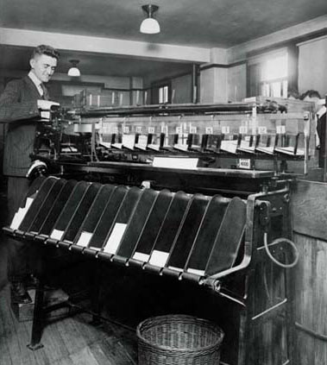
Beating the lower bound
We can beat the lower bound if we don’t base our sort on comparisons:
  Counting sort for keys in [0..k], k=O(n)
  Radix sort for keys with a fixed number of “digits”
  Bucket sort for random keys (uniformly distributed)

Slide 36
Counting Sort
Depends on a key assumption: numbers to be sorted are integers in {0, 1, 2, …, k}.
Input: A[1..n] , where A[j] ∈ {0, 1, 2, …, k} for j = 1, 2, …, n. Array A and values n and k are given as parameters.
Output: B[1..n] sorted. B is assumed to be already allocated and is given as a parameter.
Auxiliary Storage: C[0..k]
Runs in linear time if k = O(n).
Basic idea:
  Count number of elements k ≤ each element i
  Use that number to place i in position k of sorted array

Slide 37
Example:
A={2,5,3,0,2,3,0,3}, K=5, Hence, C with 6 elements.
C={2,0,2,3,0,1} = number of elements which equal to i for i=0,1,…k.
C={2,2,4,7,7,8}=Number of elements that are less than or equal to i.

Slide 38
Counting-Sort (A, B, k)
CountingSort(A, B, k)
1. for i ← 1 to k
2. do C[i] ← 0
3. for j ← 1 to length[A]
4. do C[A[j]] ← C[A[j]] + 1
5. for i ← 2 to k
6. do C[i] ← C[i] + C[i –1]
7. for j ← length[A] downto 1
8. do B[C[A[ j ]]] ← A[j]
9. C[A[j]] ← C[A[j]]–1
O(k)
O(n)
O(k)
O(n)

Slide 39
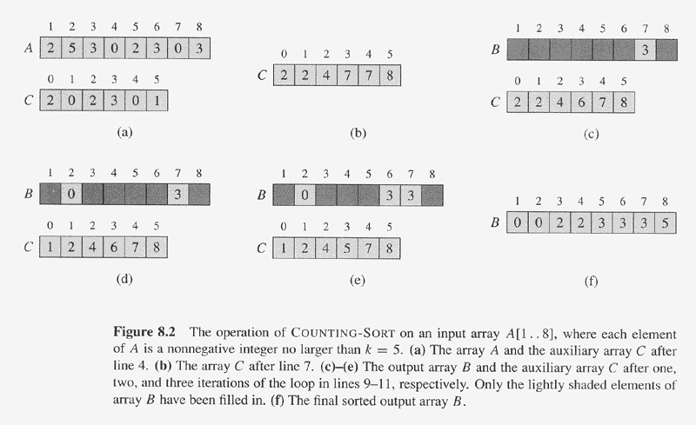
Example of Counting Sort

Slide 40
Analysis of COUNTING-SORT(A,B,k)
for i←0 to k Θ(k)
do C[i] ←0 Θ(1)
for j ←1 to length[A] Θ(n)
do C[A[j]] ←C[A[j]]+1 Θ(1) (Θ(1) Θ(n)= Θ(n))
// C[i] contains number of elements equal to i. Θ(0)
for i ←1 to k Θ(k)
do C[i]=C[i]+C[i-1] Θ(1) (Θ(1) Θ(n)= Θ(n))
// C[i] contains number of elements ≤ i. Θ(0)
for j ←length[A] downto 1 Θ(n)
do B[C[A[j]]] ←A[j] Θ(1) (Θ(1) Θ(n)= Θ(n))
C[A[j]] ←C[A[j]]-1 Θ(1) (Θ(1) Θ(n)= Θ(n))
Total cost is Θ(k+n), suppose k=O(n), then total cost is Θ(n). Beat Ω(nlg n).

Slide 41
Algorithm Analysis
The overall time is O(n+k). When we have k=O(n), the worst case is O(n).
  for-loop of lines 1-2 takes time O(k)
  for-loop of lines 3-4 takes time O(n)
  for-loop of lines 5-6 takes time O(k)
  for-loop of lines 7-9 takes time O(n)
Stable, but not in place.
No comparisons made: it uses actual values of the elements to index into an array.

Slide 42
What values of k are practical?
Good for sorting 32-bit values? No. Why?
16-bit? Probably not.
8-bit? Maybe, depending on n.
4-bit? Probably, (unless n is really small).
Counting sort will be used in radix sort.

Slide 43
Counting Sort
Cool! Why don’t we always use counting sort?
Because it depends on range k of elements
Could we use counting sort to sort 32 bit integers? Why or why not?
Answer: no, k too large (2³² = 4,294,967,296)

Slide 44
Radix Sort
Used to sort on card-sorters:
Do a stable sort on each column,
one column at a time.
The human operator is
part of the algorithm!
Key idea: sort on the “least significant digit” first and on the remaining digits in sequential order. The sorting method used to sort each digit must be “stable”.
  If we start with the “most significant digit”, we’ll need extra storage.

Slide 45
Radix Sort
It was used by the card-sorting machines.
Card sorters worked on one column at a time.
It is the algorithm for using the machine that extends the technique to multi-column sorting.
The human operator was part of the algorithm!
Key idea: sort on the “least significant digit” first and on the remaining digits in sequential order. The sorting method used to sort each digit must be “stable”.
  If we start with the “most significant digit”, we’ll need extra storage.

Slide 46
An Example
Input
After sorting
on LSD
After sorting
on middle
digit
After sorting
on MSD
392 631 928 356
356 392 631 392
446 532 532 446
928 ⇒ 495 ⇒ 446 ⇒ 495
631 356 356 532
532 446 392 631
495 928 495 928
↑ ↑ ↑

Slide 47
Radix-Sort(A, d)
RadixSort(A, d)
1. for i ← 1 to d
2. do use a stable sort to sort array A on digit i
Correctness of Radix Sort
By induction on the number of digits sorted.
Assume that radix sort works for d – 1 digits.
Show that it works for d digits.
Radix sort of d digits ≡ radix sort of the low-order d – 1 digits followed by a sort on digit d .

Slide 48
Correctness of Radix Sort
By induction hypothesis, the sort of the low-order d – 1 digits works, so just before the sort on digit d , the elements are in order according to their low-order d – 1 digits. The sort on digit d will order the elements by their d^{th} digit.
Consider two elements, a and b, with d^{th} digits a_{d} and b_{d}:
If a_{d} < b_{d} , the sort will place a before b, since a < b regardless of the low-order digits.
If a_{d} > b_{d} , the sort will place a after b, since a > b regardless of the low-order digits.
If a_{d} = b_{d} , the sort will leave a and b in the same order, since the sort is stable. But that order is already correct, since the correct order of is determined by the low-order digits when their d^{th} digits are equal.

Slide 49
Algorithm Analysis of Radix Sort
Each pass over n d-digit numbers then takes time Θ(n+k). (Assuming counting sort is used for each pass.)
There are d passes, so the total time for radix sort is Θ(d (n+k)).
When d is a constant and k = O(n), radix sort runs in linear time.
Radix sort, if uses counting sort as the intermediate stable sort, does not sort in place.
  If primary memory storage is an issue, quicksort or other sorting methods may be preferable.

Slide 50
Radix Sort
What sort will we use to sort on digits?
Counting sort is obvious choice:
  Sort n numbers on digits that range from 1..k
  Time: O(n + k)
Each pass over n numbers with d digits takes time O(n+k), so total time O(dn+dk)
  When d is constant and k=O(n), takes O(n) time
How many bits in a computer word?

Slide 51
Radix Sort
Problem: sort 1 million 64-bit numbers
  Treat as four-digit radix 2¹⁶ numbers
  Can sort in just four passes with radix sort!
Compares well with typical O(n lg n) comparison sort
  Requires approx lg n = 20 operations per number being sorted
So why would we ever use anything but radix sort?

Slide 52
Radix Sort
In general, radix sort based on counting sort is
  Fast
  Asymptotically fast (i.e., O(n))
  Simple to code
  A good choice
To think about: Can radix sort be used on floating-point numbers?

Slide 53
Bucket Sort
Assumes input is generated by a random process that distributes the elements uniformly over [0, 1).
Idea:
  Divide [0, 1) into n equal-sized buckets.
  Distribute the n input values into the buckets.
  Sort each bucket.
  Then go through the buckets in order, listing elements in each one.

Slide 54
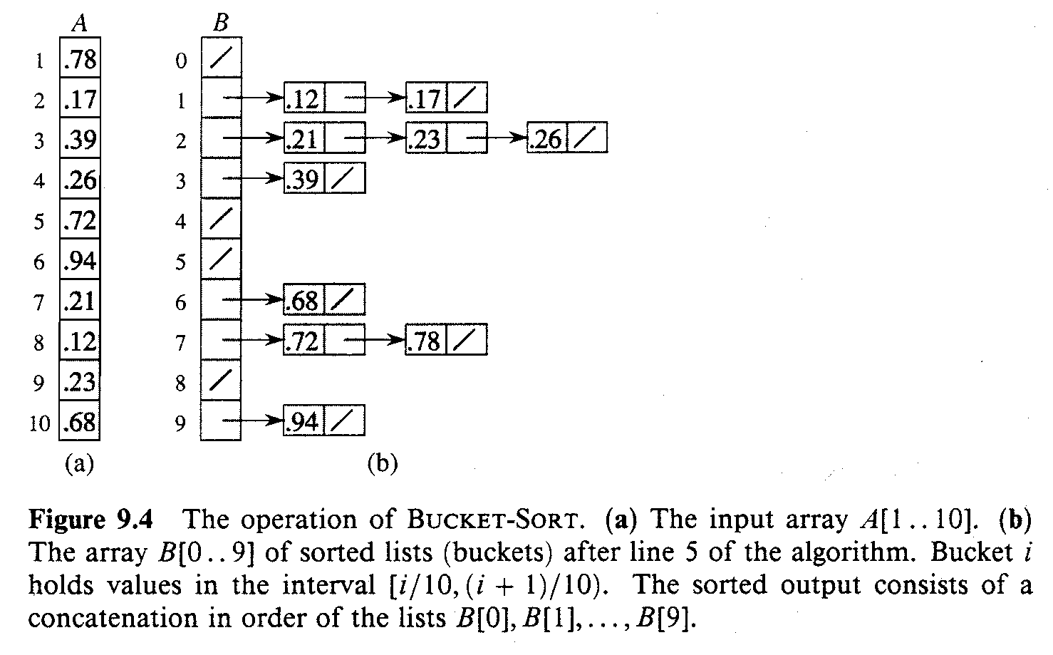
An Example

Slide 55
Bucket-Sort (A)
Input: A[1..n], where 0 ≤ A[i] < 1 for all i.
Auxiliary array: B[0..n – 1] of linked lists, each list initially empty.
BucketSort(A)
1. n ← length[A]
2. for i ← 1 to n
3. do insert A[i] into list B[ ⎣nA[i]⎦ ]
4. for i ← 0 to n – 1
5. do sort list B[i] with insertion sort
concatenate the lists B[i]s together in order
return the concatenated lists

Slide 56
Correctness of BucketSort
Consider A[i], A[j]. Assume w.o.l.o.g, A[i] ≤ A[j].
Then, ⎣n × A[i]⎦ ≤ ⎣n × A[j]⎦.
So, A[i] is placed into the same bucket as A[j] or into a bucket with a lower index.
  If same bucket, insertion sort fixes up.
  If earlier bucket, concatenation of lists fixes up.

Slide 57
Analysis
Relies on no bucket getting too many values.
All lines except insertion sorting in line 5 take O(n) altogether.
Intuitively, if each bucket gets a constant number of elements, it takes O(1) time to sort each bucket ⇒ O(n) sort time for all buckets.
We “expect” each bucket to have few elements, since the average is 1 element per bucket.
But we need to do a careful analysis.

Slide 58
Analysis of BUCKET-SORT(A)
n ←length[A] Ω(1)
for i ←1 to n O(n)
do insert A[i] into bucket B[⎣nA[i]⎦] Ω(1) (i.e. total O(n))
for i ←0 to n-1 O(n)
do sort bucket B[i] with insertion sort O(n_{i}²) (∑_{i=0}^{n-1} O(n_{i}²))
Concatenate bucket B[0],B[1],…,B[n-1] O(n)
Where n_{i} is the size of bucket B[i].
Thus T(n) = Θ(n) + ∑_{i=0}^{n-1} O(n_{i}²)
= Θ(n) + nO(2-1/n) = Θ(n). Beat Ω(nlg n)

Slide 59
Order Statistics

Slide 60
Order Statistic
i^{th} order statistic: i^{th} smallest element of a set of n elements.
Minimum: first order statistic.
Maximum: n^{th} order statistic.
Median: “half-way point” of the set.
  Unique, when n is odd – occurs at i = (n+1)/2.
  Two medians when n is even.
    Lower median, at i = n/2.
    Upper median, at i = n/2+1.
    For consistency, “median” will refer to the lower median.

Slide 61
Selection Problem
Selection problem:
  Input: A set A of n distinct numbers and a number i, with 1≤ i ≤ n.
  Ouput: the element x ∈ A that is larger than exactly i – 1 other elements of A.
Can be solved in O(n lg n) time. How?
We will study faster linear-time algorithms.
  For the special cases when i = 1 and i = n.
  For the general problem.

Slide 62
O(nlg n) Algorithm
Suppose n elements are sorted by an O(nlg n) algorithm, e.g., MERGE-SORT
  Minimum: the first element
  Maximum: the last element
  The ith order statistic: the ith element.
  Median:
    If n is odd, then ((n+1)/2)th element.
    If n is even,
      then (⎣(n+1)/2⎦)th element, lower median
      then (⎡(n+1)/2⎤)th element, upper median
All selections can be done in O(1), so total: O(nlg n).
Can we do better?

Slide 63
Minimum (Maximum)
Minimum (A)
1. min ← A[1]
2. for i ← 2 to length[A]
3. do if min > A[i]
4. then min ← A[i]
5. return min
Maximum can be determined similarly.
T(n) = Θ(n).
No. of comparisons: n – 1.
Can we do better? Why not?
Minimum(A) has worst-case optimal # of comparisons.

Slide 64
Simultaneous Minimum and Maximum
Some applications need to determine both the maximum and minimum of a set of elements.
  Example: Graphics program trying to fit a set of points onto a rectangular display.
Independent determination of maximum and minimum requires 2n – 2 comparisons.
Can we reduce this number?
  Yes.

Slide 65
Simultaneous Minimum and Maximum
Maintain minimum and maximum elements seen so far.
Process elements in pairs.
  Compare the smaller to the current minimum and the larger to the current maximum.
  Update current minimum and maximum based on the outcomes.
No. of comparisons per pair = 3. How?
No. of pairs ≤ ⎣n/2⎦.
  For odd n: initialize min and max to A[1]. Pair the remaining elements. So, no. of pairs = ⎣n/2⎦.
  For even n: initialize min to the smaller of the first pair and max to the larger. So, remaining no. of pairs = (n – 2)/2 < ⎣n/2⎦.

Slide 66
Simultaneous Minimum and Maximum
Total no. of comparisons, C ≤ 3⎣n/2⎦.
  For odd n: C = 3⎣n/2⎦.
  For even n: C = 3(n – 2)/2 + 1 (For the initial comparison).
  = 3n/2 – 2 < 3⎣n/2⎦.

Slide 67
Minimum and Maximum: 3 ⎣n/2⎦ comparisons
How about both MINIMUM and MAXIMUM at same time??
Keep both min and max, and make comparisons separately.
Thus total 2(n-1) comparisons.
Can we do better???
#pairs: ⎣n/2⎦
#comparisons/per pair:3
# total comparisons: 3 ⎣n/2⎦
MIN-MAX(A) //assume n is odd
min ←max←A[1]
for i ←2 to length[A] step 2
do if A[i]<A[i+1]
then if min>A[i]
then min ← A[i]
if max<A[i+1]
then max ← A[i+1]
else if min> A[i+1]
then min ← A[i+1]
if max<A[i]
then max ← A[i]
return min, max
Similarly, write the code
for n being even. The # total
comparisons is 3n/2-2, i.e.,
at most 3 ⎣n/2⎦ .

Slide 68
General Selection Problem
Seems more difficult than Minimum or Maximum.
  Yet, has solutions with same asymptotic complexity as Minimum and Maximum.
We will study 2 algorithms for the general problem.
  One with expected linear-time complexity.
  A second, whose worst-case complexity is linear.

Slide 69
Selection in Expected Linear Time
Modeled after randomized quicksort.
Exploits the abilities of Randomized-Partition (RP).
  RP returns the index k in the sorted order of a randomly chosen element (pivot).
    If the order statistic we are interested in, i, equals k, then we are done.
    Else, reduce the problem size using its other ability.
  RP rearranges the other elements around the random pivot.
    If i < k, selection can be narrowed down to A[1..k – 1].
    Else, select the (i – k)th element from A[k+1..n].
    (Assuming RP operates on A[1..n]. For A[p..r], change k appropriately.)

Slide 70
Randomized Quicksort
Want to make running time independent of input ordering.
How can we do that?
  Make the algorithm randomized.
  Make every possible input equally likely.
    Can randomly shuffle to permute the entire array.
    For quicksort, it is sufficient if we can ensure that every element is equally likely to be the pivot.
    So, we choose an element in A[p..r] and exchange it with A[r].
    Because the pivot is randomly chosen, we expect the partitioning to be well balanced on average.

Slide 71
Randomized Quicksort: review
Quicksort(A, p, r)
if p < r then
q := Rnd-Partition(A, p, r);
Quicksort(A, p, q – 1);
Quicksort(A, q + 1, r)
fi
Rnd-Partition(A, p, r)
i := Random(p, r);
A[r] ↔ A[i];
x, i := A[r], p – 1;
for j := p to r – 1 do
if A[j] ≤ x then
i := i + 1;
A[i] ↔ A[j]
fi
od;
A[i + 1] ↔ A[r];
return i + 1
A[p..r]
5
A[p..q – 1]
A[q+1..r]
Partition
5
≤ 5
≥ 5

Slide 72
Selection in Expected Linear Time O(n)
Select ith element
A divide-and-conquer algorithm RANDOMIZED-SELECT
Similar to quicksort, partition the input array recursively
Unlike quicksort, which works on both sides of the partition, just work on one side of the partition.
  Called prune-and-search, prune one side, just search the other side).

Slide 73
Randomized Selection
Key idea: use partition() from quicksort
  But, only need to examine one subarray
  This savings shows up in running time: O(n)
We will again use a slightly different partition than the book:
  q = RandomizedPartition(A, p, r)
≤ A[q]
≥ A[q]
p
q
r

Slide 74
Randomized Selection
RandomizedSelect(A, p, r, i)
if (p == r) then return A[p];
q = RandomizedPartition(A, p, r)
k = q - p + 1;
if (i == k) then return A[q]; // not in book
if (i < k) then
return RandomizedSelect(A, p, q-1, i);
else
return RandomizedSelect(A, q+1, r, i-k);
k
≤ A[q]
≥ A[q]
p
q
r

Slide 75
Randomized Selection
Analyzing RandomizedSelect()
  Worst case: partition always 0:n-1
    T(n) = T(n-1) + O(n) = ???
    = O(n²) (arithmetic series)
    Worse than sorting!
  “Best” case: suppose a 9:1 partition
    T(n) = T(9n/10) + O(n) = ???
    = O(n) (Master Theorem, case 3)
    Better than sorting!
    What if this had been a 99:1 split?

Slide 76
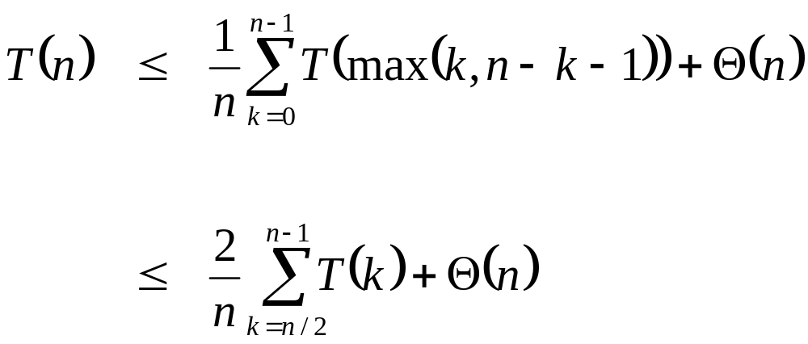
Randomized Selection
Average case
  For upper bound, assume ith element always falls in larger side of partition:
  Let’s show that T(n) = O(n) by substitution
What happened here?

Slide 77
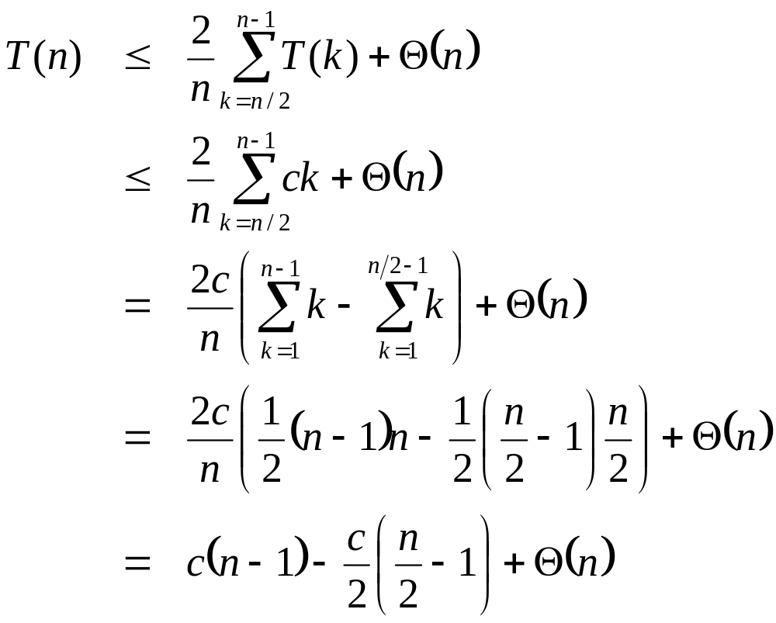
Randomized Selection
Assume T(n) ≤ cn for sufficiently large c:
The recurrence we started with
Substitute T(n) ≤ cn for T(k)
What happened here?
What happened here?
“Split” the recurrence
Expand arithmetic series
What happened here?
Multiply it out
What happened here?

Slide 78
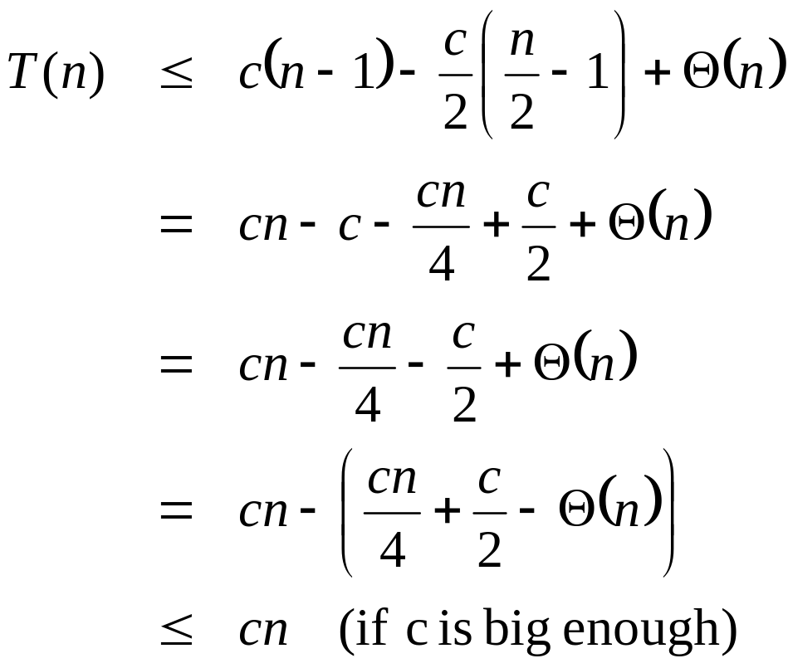
Randomized Selection
Assume T(n) ≤ cn for sufficiently large c:
The recurrence so far
What happened here?
Multiply it out
What happened here?
Subtract c/2
Rearrange the arithmetic
What happened here?
What we set out to prove
What happened here?

Slide 79
Worst-Case Linear-Time Selection
Randomized algorithm works well in practice
What follows is a worst-case linear time algorithm, really of theoretical interest only
Basic idea:
  Generate a good partitioning element
  Call this element x

Slide 80
Selection in Worst-Case Linear Time
Algorithm Select:
  Like RandomizedSelect, finds the desired element by recursively partitioning the input array.
  Unlike RandomizedSelect, is deterministic.
    Uses a variant of the deterministic Partition routine.
    Partition is told which element to use as the pivot.
  Achieves linear-time complexity in the worst case by
    Guaranteeing that the split is always “good” at each Partition.
    How can a good split be guaranteed?

Slide 81
Guaranteeing a Good Split
We will have a good split if we can ensure that the pivot is the median element or an element close to the median.
Hence, determining a reasonable pivot is the first step.

Slide 82
Choosing a Pivot
Median-of-Medians:
  Divide the n elements into ⎡n/5⎤ groups.
    ⎣ n/5⎦ groups contain 5 elements each. 1 group contains n mod 5 < 5 elements.
    Determine the median of each of the groups.
      Sort each group using Insertion Sort. Pick the median from the sorted list of group elements.
    Recursively find the median x of the ⎡n/5⎤ medians.
Recurrence for running time (of median-of-medians):
  T(n) = O(n) + T(⎡n/5⎤).

Slide 83
Algorithm Select
Determine the median-of-medians x (using the procedure on the previous slide.)
Partition the input array around x using the variant of Partition.
Let k be the index of x that Partition returns.
If k = i, then return x.
Else if i < k, then apply Select recursively to A[1..k–1] to find the i^{th} smallest element.
Else if i > k, then apply Select recursively to A[k+1..n] to find the (i – k)^{th} smallest element.
(Assumption: Select operates on A[1..n]. For subarrays A[p..r], suitably change k. )

Slide 84
Worst-case Split
Arrows point from larger to smaller elements.
Elements < x
⎣n/5⎦ groups of 5 elements each.
⎡n/5⎤^{th} group of n mod 5
elements.
Median-of-medians, x
Elements > x

Slide 85
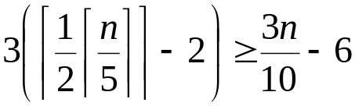
Worst-case Split
Assumption: Elements are distinct. Why?
At least half of the ⎡n/5⎤ medians are greater than x.
Thus, at least half of the ⎡n/5⎤ groups contribute 3 elements that are greater than x.
  The last group and the group containing x may contribute fewer than 3 elements. Exclude these groups.
Hence, the no. of elements > x is at least
Analogously, the no. of elements < x is at least 3n/10–6.
Thus, in the worst case, Select is called recursively on at most 7n/10+6 elements.

Slide 86
Recurrence for worst-case running time
T(Select) ≤ T(Median-of-medians) +T(Partition) +T(recursive call to select)
T(n) ≤ O(n) + T(⎡n/5⎤) + O(n) + T(7n/10+6)
= T(⎡n/5⎤) + T(7n/10+6) + O(n)
Assume T(n) ≤ Θ(1), for n ≤ 140.
T(Median-of-medians)
T(Partition)
T(recursive call)

Slide 87
Solving the recurrence
To show: T(n) = O(n) ≤ cn for suitable c and all n > 0.
Assume: T(n) ≤ cn for suitable c and all n ≤ 140.
Substituting the inductive hypothesis into the recurrence,
  T(n) ≤ c ⎡n/5⎤ + c(7n/10+6)+an
  ≤ cn/5 + c + 7cn/10 + 6c + an
  = 9cn/10 + 7c + an
  = cn +(–cn/10 + 7c + an)
  ≤ cn, if –cn/10 + 7c + an ≤ 0.
n/(n–70) is a decreasing function of n. Verify.
Hence, c can be chosen for any n = n₀ > 70, provided it can be assumed that T(n) = O(1) for n ≤ n₀.
Thus, Select has linear-time complexity in the worst case.
–cn/10 + 7c + an ≤ 0 ≡ c ≥ 10a(n/(n – 70)), when n > 70.
For n ≥ 140, c ≥ 20a.

Slide 88
Selection in worst case linear time O(n)
Select the ith smallest element of S={a₁, a₂,…, a_{n}}
Use so called prune-and-search technique:
  Let x∈ S, and partition S into three subsets
  S₁={a_{j} | a_{j} <x}, S₂={a_{j} | a_{j} =x}, S₃={a_{j} | a_{j} >x}
  If | S₁ |>i, search ith smallest element in S₁ recursively, (prune S₂ and S₃ away)
  Else If | S₁ |+| S₂ |>i, then return x (the ith smallest element)
  Else search (i-(| S₁ |+| S₂ |))th in S₃ recursively, (prune S₁ and S₂ away)
The question is how to select x such that S₁ and S₃ are nearly equal.?

